Slide 1

COMP 90049
Knowledge Technologies
Week 4
我们毕业啦
其实是答辩的标题地方
Tutor
Ang Li

Slide 2
Name: Ang Li
E-mail: angl4@student.unimelb.edu.au
Contact information
Research topic: computer vision

Slide 3
Summery
Work through this week’s exercise
Notes:
Secure File Transfer Protocol
Secure Shell

Slide 4
Suppose that we have observed the token “lended”, and a dictionary as follows:
addendum
blenders
commodity
deaden
end
leader
leant
lent
lemonade
pleading

Slide 5
Exercise 1:
Which, if any, of the above dictionary entries would be returned using a Neighbourhood Search with a neighbourhood of 1? 2? 3?:

Slide 6
Neighbourhood Search
For a given string w of interest:
Generate all variants of w that utilize at most k changes (Insertions/Deletions/Replacements) — neighbours
Check whether generated variants exist in dictionary
All results found in dictionary are returned

Slide 7
Exercise 1:
There aren't any items in the dictionary requiring only a single change from “lended”.
With a neighbourhood of 2, there is a dictionary entry:
“leader”, by Replacing the n with a, and the second d with r
Along with the above, the following are also within a neighbourhood of 3:
“blenders”, by Inserting the b, Replacing the second d with r, and Inserting the s
“deaden” (three Replaces)
“end” (three Deletions)
“lent” (one Replace and two Deletions)

Slide 8
Exercise 2:
With respect to the input string lended and the dictionary entry “deaden”, calculate the following:
the Global Edit Distance, using the parameter [m; i; d; r ] = [+1; -1; -1; -1]
the Local Edit Distance, using the parameter [m; i; d; r ] = [+1; -1; -1; -1]
the N-Gram Distance, using n = 2

Slide 9
Global Edit Distance
Scan through each dictionary entry looking for the “best” match.
Transform the string of interest into each dictionary entry, using the operations Insert, Delete, Replace, and Match (character).
Each operation is associated with a score.

Slide 10
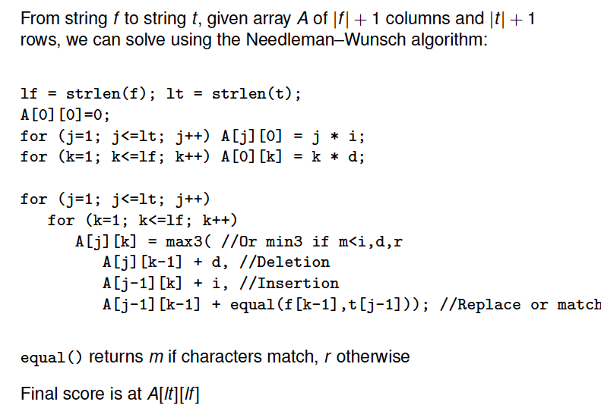
Global Edit Distance

Slide 11
Local Edit Distance
Local Edit Distance is like Global Edit Distance, but we are searching for the best substring match.
Particularly suitable when comparing two strings of very different lengths, e.g. a word and a sentence.

Slide 12
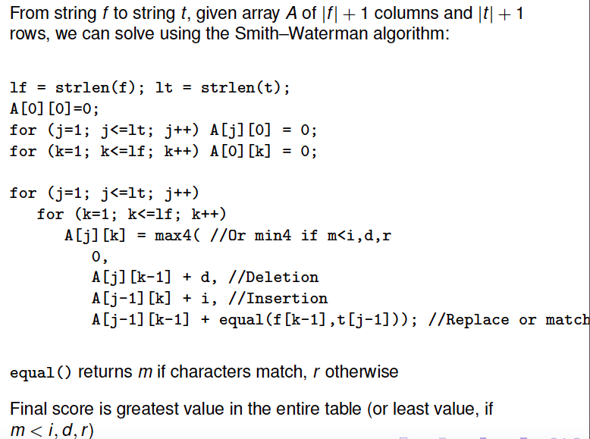
Local Edit Distance

Slide 13
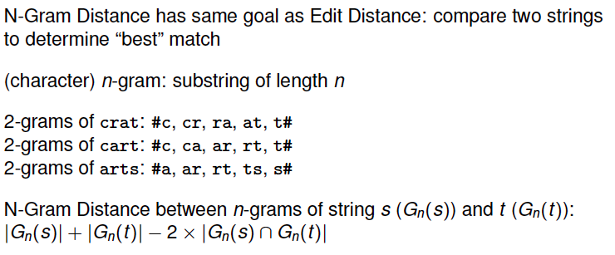
N-Gram Distance

Slide 14
Exercise 3:
Find the best approximate match (or matches, if there are ties) in the dictionary for the string “lended” , based on the following methods; consider different parameters where necessary:
the Global Edit Distance
the Local Edit Distance
the N-Gram Distance n=3

Slide 15
Exercise 4:
Assuming that the correct (intended) dictionary entry was “lent”, calculate the precision of each
of the above methods of ending approximate entries from the dictionary.
Neighbourhood Search of 1, 2, 3
the Global Edit Distance
the Local Edit Distance
the N-Gram Distance n=3

Slide 16
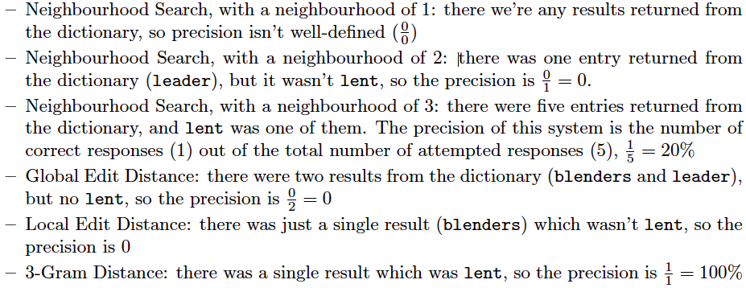

Slide 17
Thanks!

